Slide 1

Fort Worth Housing Solutions
“Investing in the Community”
2024 LANDLORD ORIENTATION
http://www.fwhs.org

Slide 2
WELCOME
Thank you for choosing to participate in the
Fort Worth Housing Solutions
Housing Program

Slide 3
Housing Program Overview
The Housing Choice Voucher program (HCV) is a federally funded program designed to help eligible low-income individuals/families, the elderly and persons with disabilities to reside in safe, decent and affordable housing.
The HCV program encourages freedom of housing options and de-concentration of assisted housing into areas outside of those in which poverty and/or minority household are concentrated.
The program provides housing assistance payments, paid directly to private owners who lease their rental units to eligible program participants.

Slide 4
Housing Programs Administered by FWHS
Housing Choice Voucher (HCV)
Homeless Programs
(CoC-Shelter Plus Care, HHSP, HCC, ESG)
Mainstream
Emergency Housing Voucher (EHV)
Veteran Affairs Supportive Housing

Slide 5
Applicable Federal, State and Local Laws
The Federal regulations governing the Housing Choice Voucher program are found in Title 24 of the Code of Federal Regulations which is accessible through the internet
Fair Housing Act 1968 Under the Fair Housing Act of 1968 it is unlawful to discriminate in Housing based on: Race, Color, National Origin, Religion, Sex, Familial Status, or Disability status
The Violence Against Women Reauthorization Act of 2005 (VAWA) prohibits denial or admission to an otherwise qualified applicant on the basis that the applicant is or has been a victim of domestic violence, dating violence, or stalking.

Slide 6
Violence Against Women Act (VAWA)
The following are various types of violent Acts against women or men
              Domestic Violence
              Dating Violence
              Stalking
              The Housing Choice Voucher Program
              Selection/admissions and continued
              occupancy provisions prohibiting denial of selection/admission or eviction/termination of assistance to individuals for reasons related to incidents of domestic violence in which they were a victim.
              *Participant must show history of abuse

Slide 7
How does the program work
Fort Worth Housing Solutions
Participant Landlord
In the program, there are three bi-party contracts

Slide 8
Program Responsibilities
Landlord
A landlord may not rent to a relative on the Housing Choice Voucher program
Landlords must abide by the terms of the Housing Contract and Lease Agreement
Landlords must maintain the dwelling unit in safe, decent condition
Housing Authority
The Housing Authority must determine applicant eligibility, make timely housing assistance payments, verify income and other information and, recertify participants annually.
The Housing Authority is responsible to inspect the assisted rental unit prior to initial occupancy and at least once annually to ensure the assisted unit is safe, decent and sanitary
The Housing Authority is also responsible to ensure that the contract rent is reasonable in comparison to other similar rental units in the area
The Housing Authority is required to comply with all applicable HUD rules and regulations
Program Participant
The tenant must abide by the terms of the lease, and the rules of the Housing Choice Voucher program, and be a good neighbor.

Slide 9
Becoming a Partner

Slide 10
Required Ownership Information
Proof of Ownership
Driver's License & Social Security Card, for individual owners
Employer Identification Number (EIN), for company-owned properties
Direct Deposit Form, along with voided check
W-9
Assignment of Agent, if unit is managed by third-party
Ratification of Existing Contract, if unit is currently occupied by FWHS clients

Slide 11
FWHS Required Forms
Direct Deposit Form
  If Agent if the payee, form must be NOTARIZED
  The payee receiving the 1099 will be responsible for providing the banking information
  A voided check or bank verification must be attached
W-9
  If owner is someone else as payee, a W-9 is required for both the owner and the payee.
  The name on W-9 must match name on social security or EIN letter
Assignment of Agent
  If someone other than owner is managing the property
  Must be NOTARIZED
Ratification of Existing Contract
  Must be completed if property is occupied by FWHS client

Slide 12
Debarments
A debarment sanction means that an individual, organization and its affiliates are excluded from conducting business with any Federal Agency government-wide.
  Who does HUD sanction?
    Landlords
    Loan Officers
    Builders and Developers
    Real Estate Brokers or Agents
    Management Agents
    Appraisers and Inspectors
    Contractors
FWHS will verify online with the Debarment list to ensure the landlord and/or Agent are NOT on the list
If the interested landlord/agent is on the Debarment list, they will not participate with the FWHS as a landlord.

Slide 13
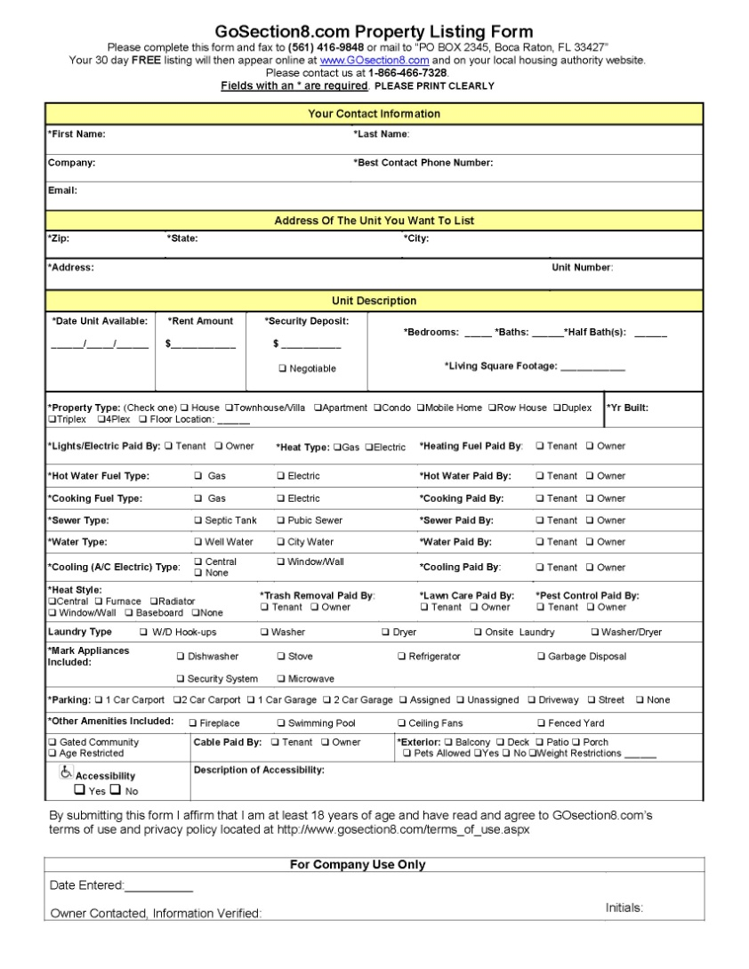
Affordablehousing.com
Property Listing Form
Three ways to list your properties for FREE:
  www.affordablehousing.com
  Toll Free Number @: 866.466.7328
  FAX @: 561.416.9848
Please use ONE form per property
Note: Existing vendors when adding a new property always provide one of the following:
  HUD Settlement Statement (signed by both Owner & Seller)
  Filed Warranty Deed
  Deed of Trust
  TAD

Slide 14
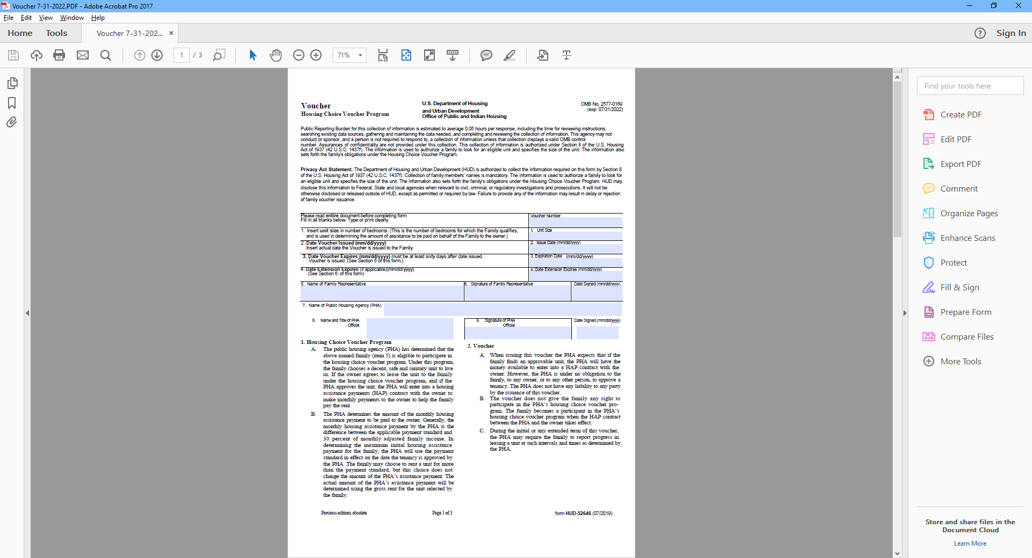
Example of Housing Choice Voucher
Voucher size is not the same as unit size
Tenant may choose a larger unit than the voucher size indicates as long as the unit is within the payment standard of the assigned voucher subisdy.
T

Slide 15
Payment Standard
Current maximum payment standards per bedroom size.
Small Area Fair Market Rents (SAFMRs) are Fair Market Rents (FMRs) calculated at the ZIP code level, rather than for the entire metropolitan region. As described in the SAFMR Final Rule, “the main benefit of SAFMRs is that, through setting rental subsidy amounts at a more local level, assisted households will be more able to afford homes in areas of high opportunity than under current policy. (see attached)

Slide 16
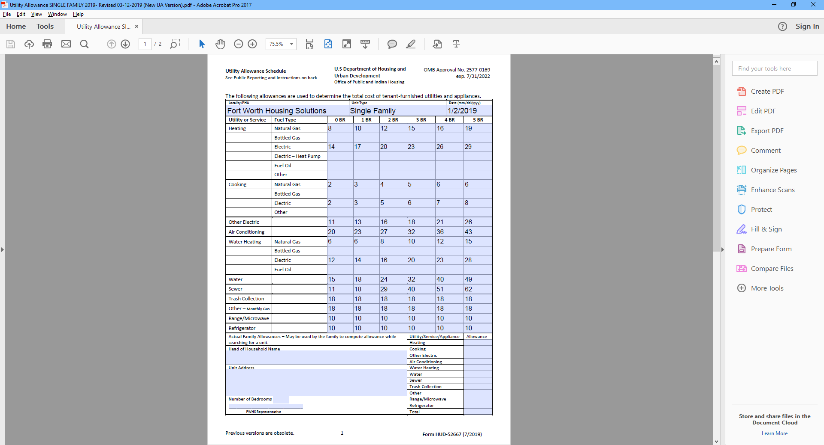
Utility Allowance Schedule https://www.fwhs.org/forms-2/
Average cost of utilities for the unit, not the actual cost
Payment Standard minus Utility Allowance equals the Adjusted Payment Standard (how much the voucher is worth)
Three types of utility allowances
  Single Family Homes
  Multi-family
  Energy Efficient

Slide 17
Inspection
Process
Inspection Directory
Request for Tenancy Approval-RFTA
Landlord Unit Checklist

Slide 18
Inspectors Directory
-by zip code- Effective March 1, 2023
FWHS INSPECTORS CONTACT INFORMATION
 | Lisa Cleveland | Igor Mendoza | Efren Herrera |  | Enrique Segura | Alonso Carrillo
 | 817.333.3656 lcleveland@fwhs.org | 817.808.6927 imedoza@fwhs.org | 817.333.3655 eherrera@fwhs.org |  | 817.333.3657 esegura@fwhs.org | 817.793.8714 acarillo@fwhs.org
 | 76105 | 75050, 75051, 75052 | 76123, 76126, 76132 |  | 76020, 76021, 76022 | All zip codes for COC Programs
 | 76112 | 75054, 76008, 76009 | 76133, 76134 |  | 76034, 76039, 76040
 | 76119, 76120 | 76028, 76036, 76053 |  |  | 76051, 76052, 76054
 |  | 76058, 76060, 76063 |  |  | 76104, 76106, 76114
 |  | 76102, 76103, 76107 |  |  | 76131, 76135, 76137
 |  | 76108, 76109, 76110 |  |  | 76148, 76164, 76177
 |  | 76111, 76115, 76116 |  |  | 76179, 76180, 76182
 |  | 76117, 76118, 76140 |  |  | 76244, 76248, 76262
 | Inspections Supervisor | Ruben Renteria |  |  | 817.333.3662 or rrenteria@fwhs.org
 | Leasing Specialist (RFTA) | Yolanda Elems |  |  | 817.333.3652 or yelems@fwhs.org
 | Inspections Clerk | Britiany Arnold |  |  | 817.333.3658 or barnold@fwhs.org
 | Inspection Clerk | Katina Huffman |  |  | 817.333.3661 or Khuffman@fwhs.org

Slide 19
REQUEST FOR TENANCY APPROVAL
RFTA FORM
List the full correct address of the unit
Specify who will be repsonsible for utilitie, as well as the stove and refrigerator
State the date the unit will be ready for isnpection
TENANT PORTION

Slide 20
REQUEST FOR TENANCY APPROVAL
RFTA FORM
Landlord and potential tenant must complete and sign the form, which must include but not limited to the following:
  The CORRECT address of the assisted unit
  The date the unit will be ready for inspection
  The contract rent for the assisted unit
The RFTA may be returned to FWHS via email at rfta@fwhs.org or dropped or mailed to our office at 1407 Texas Street, FW TX 76102
The RFTA must be submitted prior to the expiration of the Housing Choice Voucher

Slide 21
Inspection Checklist
Top 10 NSPIRE regulations
GFCI protections required at all ‘wet’ locations.
Any exposed wire (not inclusive of low-voltage) that is not properly shielded from the residents is a 24-hour deficiency.
All repairs made within the electrical systems must be completed with UL Listed material.
Non-chargeable extinguishers are only acceptable for 12 years from the manufacturer date noted on the extinguisher.
At lease on handrail (extending from the first rise to the last) is required for each continuous run of stairs/steps with four or more risers.
A vertical rise of ¾ or a horizontal separation of 2” would constitute a trip hazard.
TPR discharge pipes must be no further than 6 inches from floor/pan but no closer than 2 inches.
Sleeping rooms on the three floors require at least two points of egress (typically a door and a window).
Carbon Monoxide Detectors - all requirements of IFC Sections 915 and 1103 must be met.
Smoke Detectors - Each level of the unit including basement must have smoke detector as well as each sleeping room.

Slide 22
Keyless Deadbolts REQUIREMENTS
Keyless Deadbolts are in compliance with STATE LAW.

Slide 23
SMOKE ALARM REQUIREMENTS
Operable smoke alarms are in compliance with STATE LAW.
In compliance with recent TEXAS state legislation regarding the number and placement of smoke alarms in rental properties, FWHS requires the following for multi-family (duplex/Apartments) properties:
    Must be one on each level of the dwelling unit
    Must be installed in accordance with and meet the requirements of the National Fire Protection Association Standards 74 or its successor standards.
    If a hearing impaired person is occupying the dwelling unit, the smoke detector must have an alarm system designed for the hearing-impaired persons as specified in NFPA 74.
    Effective December 22, 2024, all battery operated smoke detectors must be a 10-year sea. If the smoke detectors are hard-wired, theycan have battery backup.
    The link beloew will provide updated information regarding smoke detectors.
    Smoke Alarms - Understanding NSPIRE Standards - 1 (us-hc.com)
  All rental units must be up to code. For more information, you may go to www.texaspropertycode.org

Slide 24
HEATING/AC REQUIREMENTS
Information on free standing heating units.
In order for a unit to pass inspection, the heating source must also be inspected and PASS
  Heating Source is defined to be a HEATER(S): WALL FURNACE, CENTRAL UNIT, OR any other APPLIANCE that provides the Actual Heat
  A GAS JET being present in a room without the heating unit actually being present is not a PASSABLE ITEM
  Unvented fuel-burning heaters are not allowed
  Cooking stoves are not considered heating units
  Portable electric units cannot be used as a Primary source of HEAT for a room
  A carbon monoxide detector must be installed by the landlord.

Slide 25
Housing Assistance
Payment Contract
HAP Contract Part A
HAP Contract Part B: Body of Contract
HAP Contract Part C: HUD Tenancy Addendum
Lease

Slide 26

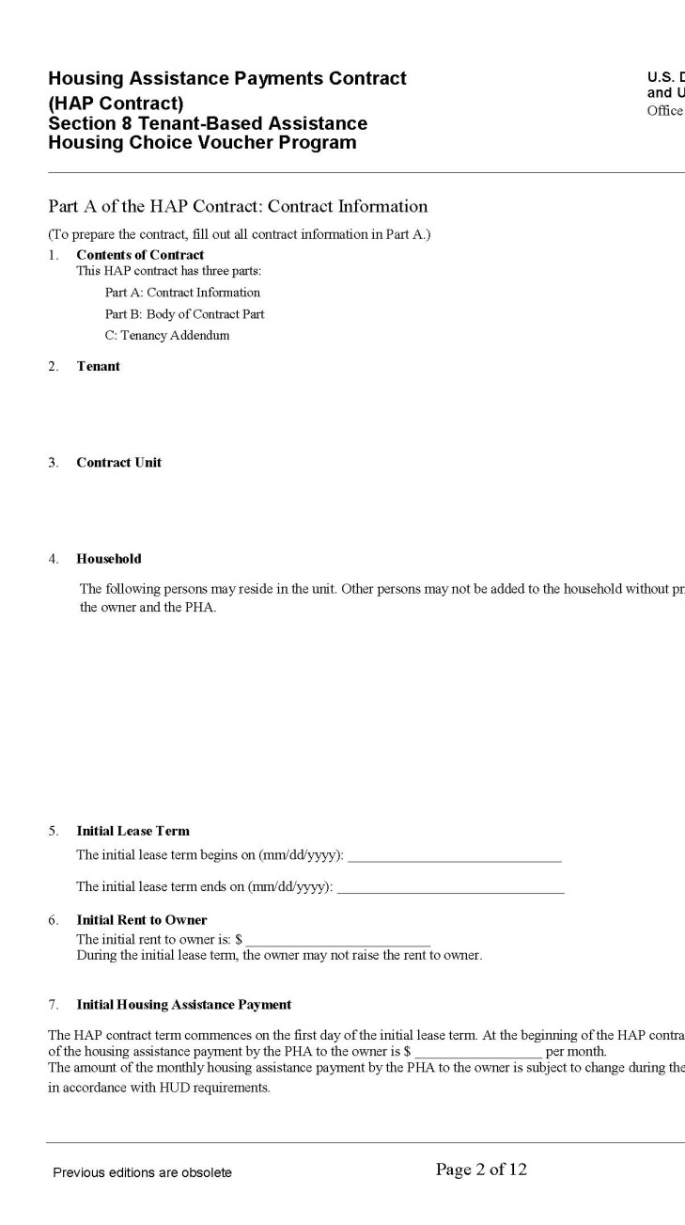
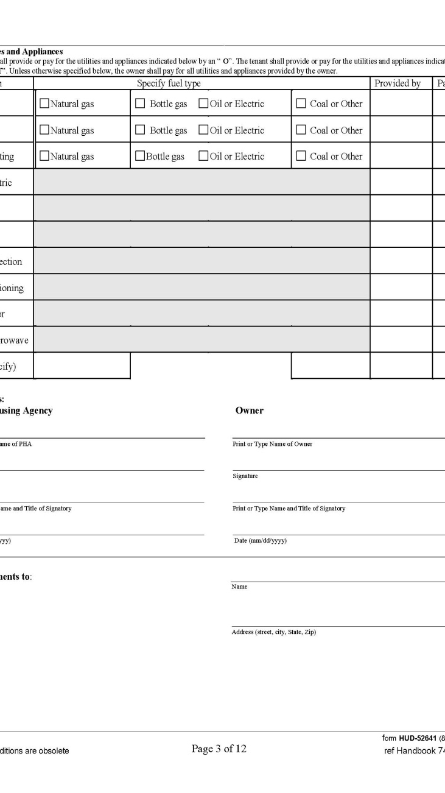
Housing Assistance Payment Contract
Part A
The Body of the HAP Contract will consist of:
  Head of Household Name
  Contract Unit Address
  Household Members
  Initial Lease Term and Expired Date
  Initial Rent to Owner
  Initial Housing Assistance Payment
  Utilities and Appliances
  Signatures from the FWHS and Owner

Slide 27
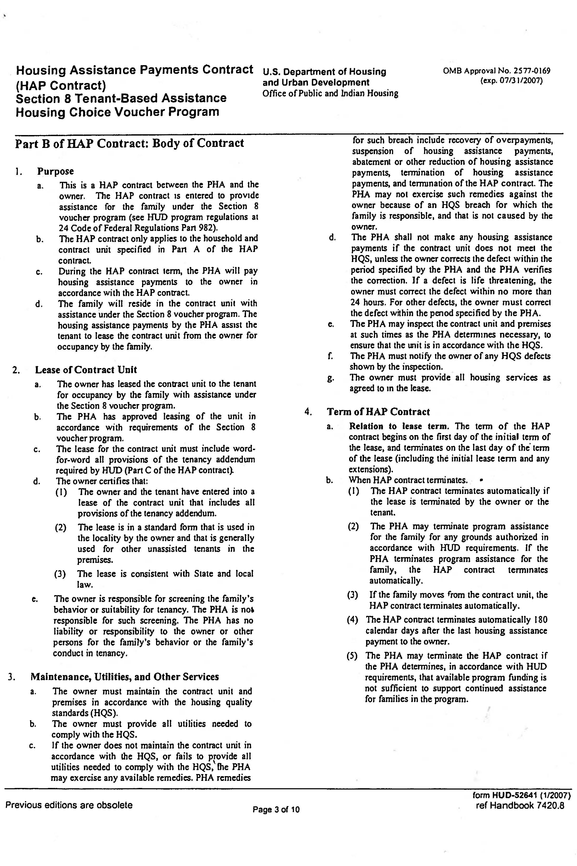
Part B of HAP Contract
Body of Contract
This is the HAP Contract between the FWHS and the Owner
The owner may not evict tenant for the FWHS portion of rent
The owner must maintain the contract unit and premises in accordance with the housing quality standards- HQS-
Please read carefully the Body of the Contract

Slide 28
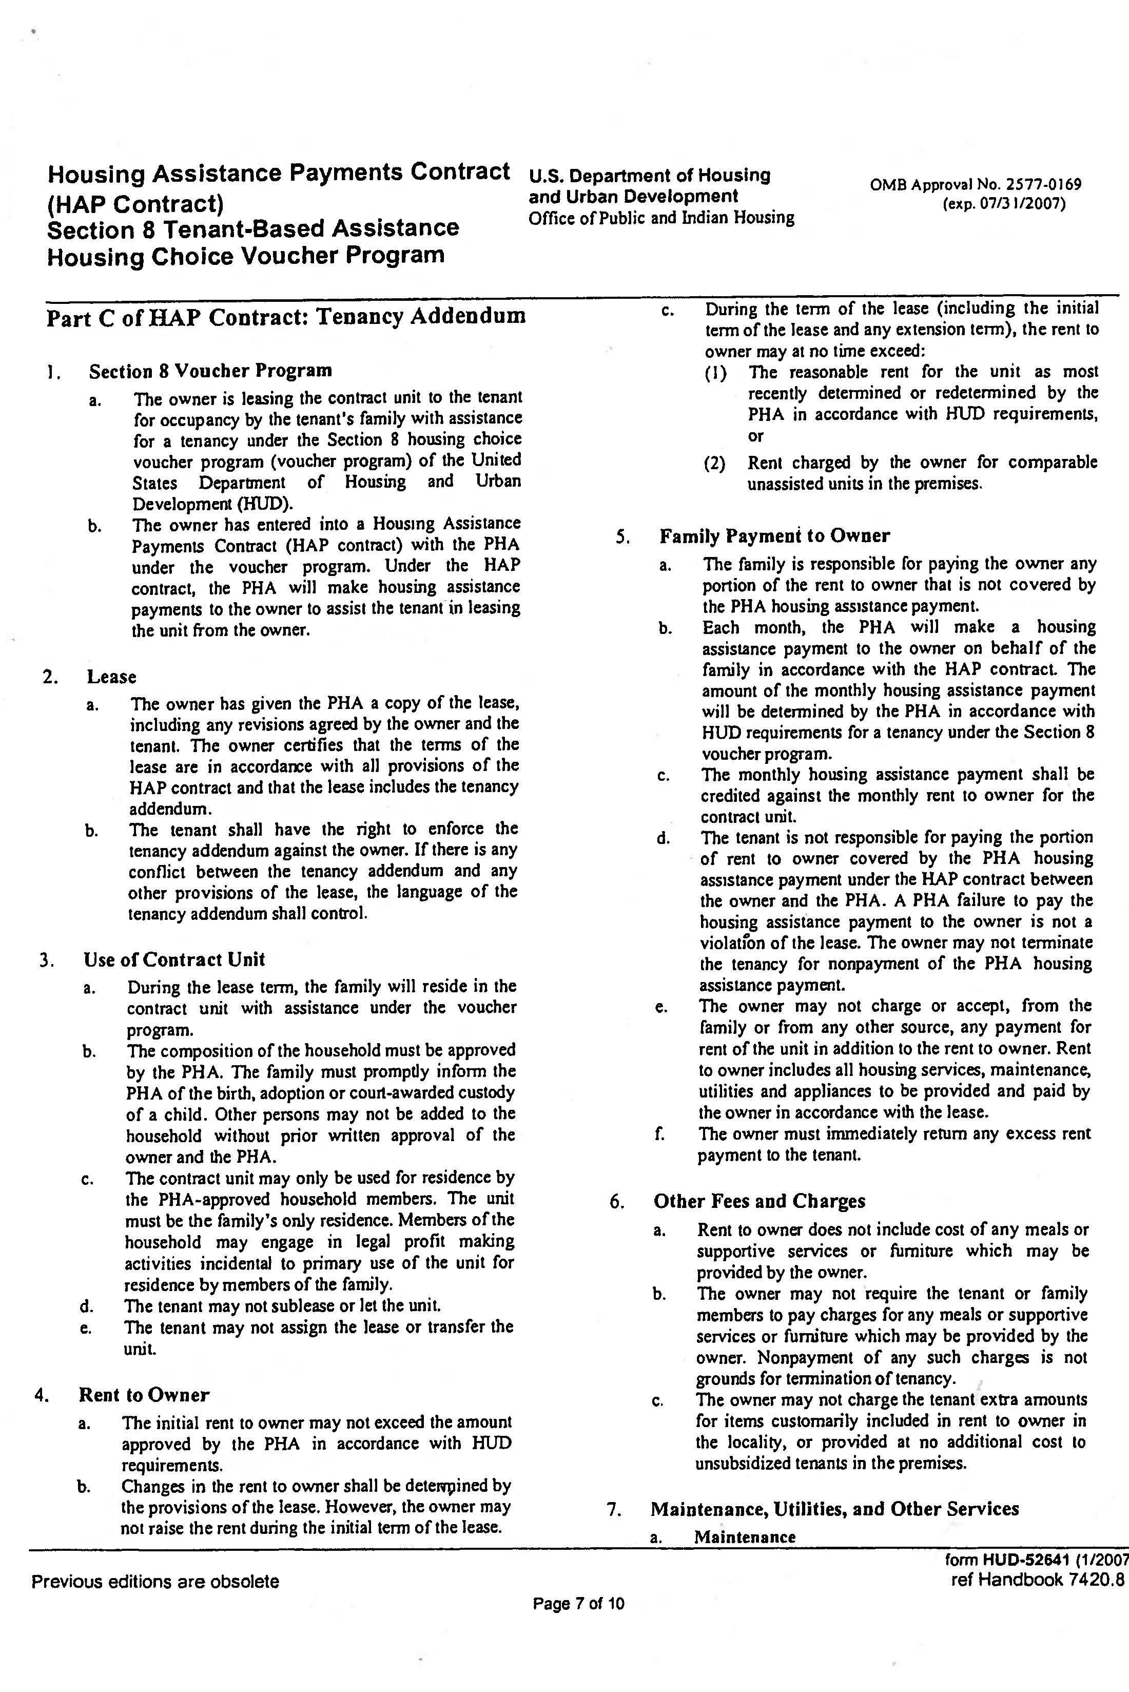
Part C of HAP Contract
HUD Tenancy Addendum
Works in conjunction with your lease and our contract and must be made part of the lease.
Landlords need to put in writing on the lease agreement between the client: “HUD Tenancy Addendum Attached is a Part of this Lease”

Slide 29
Security Deposit
A property owner may request a security deposit from the proposed tenant provided:
  The amount of the deposit is no more than that requested of private unassisted tenants
  Not more than one month's contract rent
  The security deposit is between the proposed tenant and the property owner
Collection of the Security Deposit is Strictly between the owner/agent and the prospective tenant. Deposit is to be paid in full prior to client move in
If the client fails to pay the security deposit it is between the client and the landlord…NOT the FWHS

Slide 30
Landlord Partner Portal
After your first Housing Assistance Payment
Create an Account
Visit http://www.fwhs.org
Select Landlords
Select Landlord Payment Status
Select Create an Account
  Create username
  Create password
    Enter active Social Security Number or TAX ID# to match Owner Name or Company Name
    FWHS will email a confirmation notice
    You may have multiple users to the account
    Print monthly detail statements
Notes:
Annual inspections will be displayed on the web as well…either passed or failed

Slide 31
Landlord Partner Portal
Announcements-important information from the FWHS
Upcoming Workshops/Seminars
Online Detail Statements
  Import by Excel, Access, Word, Etc….
My Units
  Inspection reports- failed items only
  Upcoming Annual Inspection
My Family
  Head of household and members listed
1099 available at the beginning of each year
REMEMBER……
  If you are a new landlord please go to www.fwhs.org, click the landlord tab, on the left hand side of the screen under “Related Links” click the resources/forms link to find the documentation that needs to be submitted.
Notes:
Annual inspections will be displayed on the web as well…either passed or failed

Slide 32
General Overview
All Housing Assistance Payments (HAP) will be paid via direct deposit.
Tenant has the right to request reasonable accommodations for disability assistance.
Lease violations must be provided in writing to the tenant and a copy must be sent to Fort Worth Housing Solutions.
Homes constructed before 1978 may have lead-based paint. Units housing elderly or children under 6 are subject to regulations. Resources: www.epa.gov/lead.
HAP payments will not be made on unit prior to passed inspection.
All properties will be inspected on an annual or bi-annual basis based on housing program requirements. Failure to make needed repairs result in abatement (no payment)
Lease dates, occupants and rent must match the contract.
Rental increases can be requested once a year. Request must be made in writing 60 days prior to the expiration of the HAP contract.

Slide 33
Thank you!!​
Have A Fabulous Day!

